Slide 1
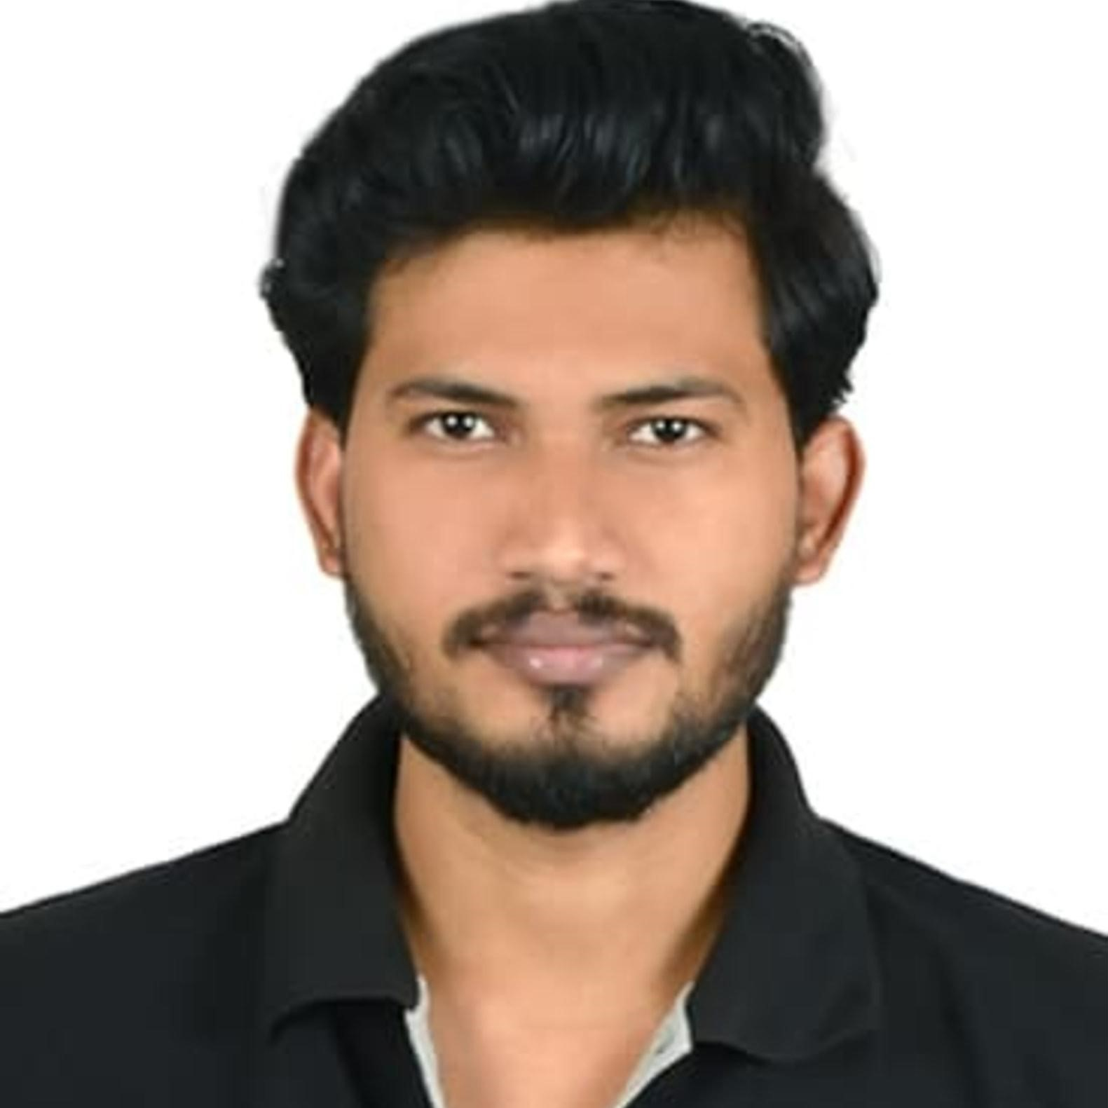



Yash Jitendra Patil
Analyst/Software Engineer
Bachelor of Engineering
ECE:2017 – 2021
Skills
PowerApps
SharePoint
Core Java
SQL
Add-ons
GitHub
Additional Details
Leadership
Excellent Communication Skills
Team management
Mumbai
YASH.JITENDRA-PATIL@CAPGEMINI.COM
+91 8208070093
A4
Software Engineer who is Strong in design and integration with intuitive problem-solving skills. Passionate about implementing and launching new projects.
Hands-on Experience in creating Traditional and Reactive applications on Powerapps.
Proficient in creating Powerapps Applications.
Eager to work in a team of dedicated people and serve a key role in the enhancement and development of the project.
1. Leave Management System (LMS) Application
Developed the leave management system application on PowerApps using SharePoint list and created a flow between SharePoint, PowerApps, and Gmail using Power Automate.
2. Completed Git, GitHub at Capgemini Degreed Platform
Learned the concepts of Git and GitHub, and simultaneously applied the concepts for better learning.
POWERAPPS DEVELOPER
Check out my work on GitHub & Video Profile

